Slide 1


Social Buzz Analysis

Slide 2


Today's agenda
Project recap
Problem
The Analytics team
Process
Insights
Summary

Slide 3

yuguygihuijkkkkkkkkkkkkkkkkkkkkkllllllllllllll
Social Buzz is a social media platform
Keeps users anonymous and tracks user reactions on every piece of content
Over 100 ways for users to react
Over the past 5 years, the platform has scaled very quickly and reaches over 500 million active users monthly
Over 100,000 pieces of content and data is made daily
Project Recap

Slide 4


Problem
With over 100,000 posts every day that makes about 3,000,000 pieces of content every month
To determine the areas of interest, lets find the most popular categories of content.

Slide 5






Chief Technology Architect:
Andrew Fleming
The Analytics team
Senior Principle:
Marcus Rompton
Data Analyst:
Andres Almaraz

Slide 6
Process
1
Examining and understanding the data model
2
Collecting the required data
3
Cleaning the datasets
4
Merging datasets
5
Analyzing the Data

Slide 7

Insights
Most Popular Categories
Travel
Science
Healthy Eating
Animals
Cooking
Content Types Popularity
Photo
Video
GIF
Audio
Month with most posts and/or highest Popularity
August
October
January
May

Slide 8
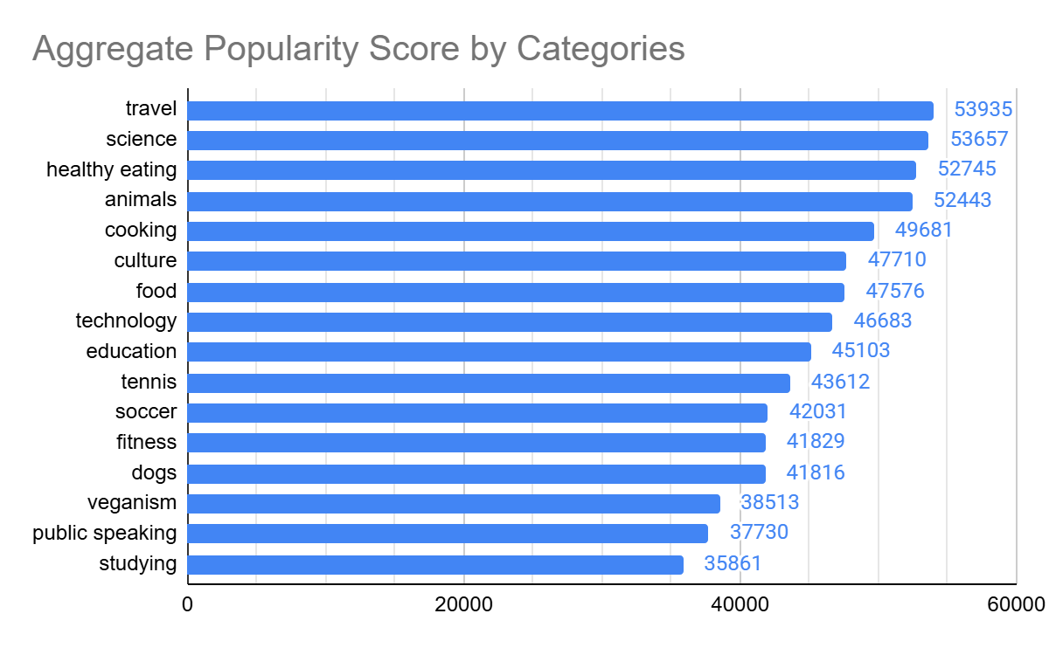
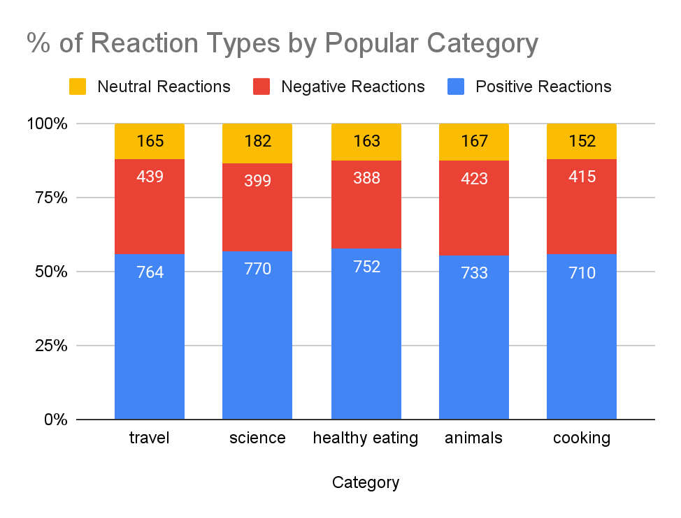
Popular Categories Insight
Top 5 categories all nearly reach or exceed 50,000 in popularity score. Travel being the highest at 53,935 in popularity score
Popular categories perform almost similar in reaction types. However, healthy eating and science is higher in positive reactions by 1-2%

Slide 9
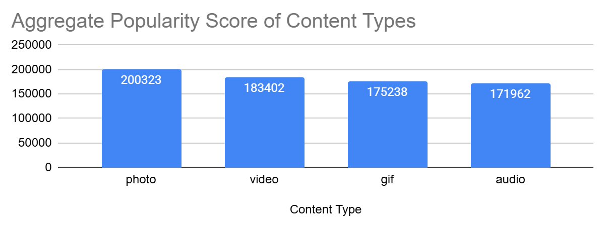
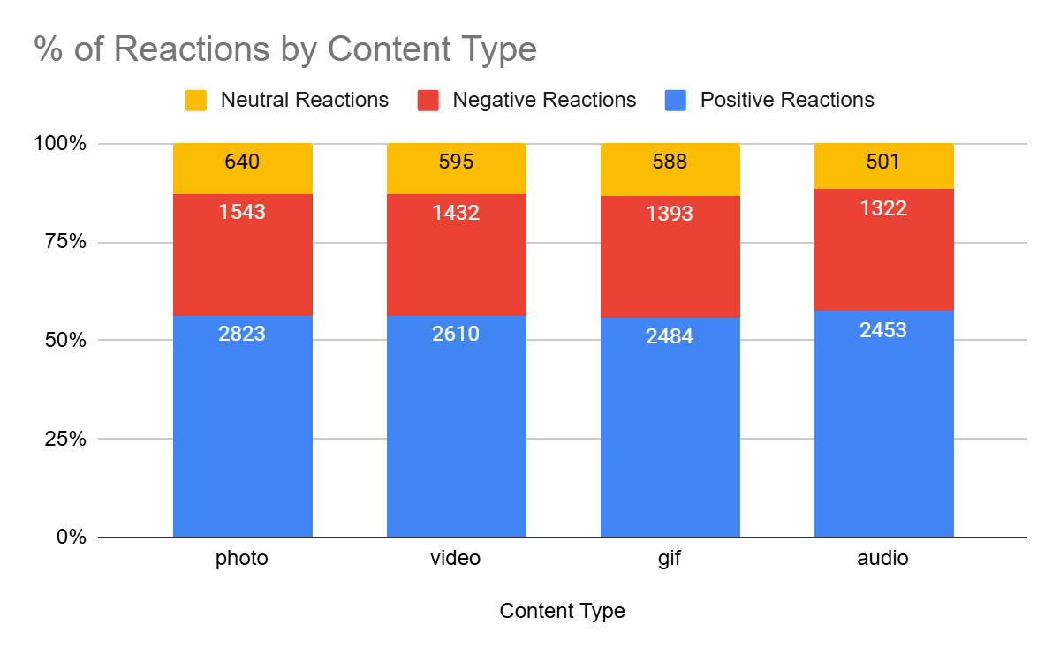
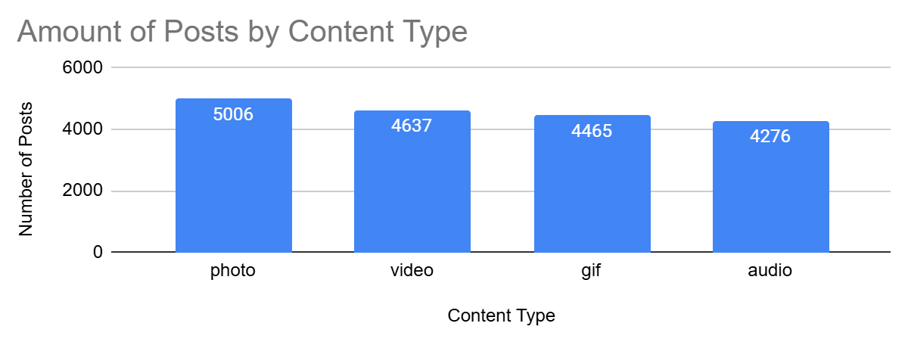
Content Type Insight
Photo is highest in both popularity and amount of posts. It would also appear that the amount of posts and popularity have a
positive correlation
The difference of % in negative reactions between content types is at most 0.4%. In positive reactions, GIF is the highest with photo being behind by 1%.

Slide 10
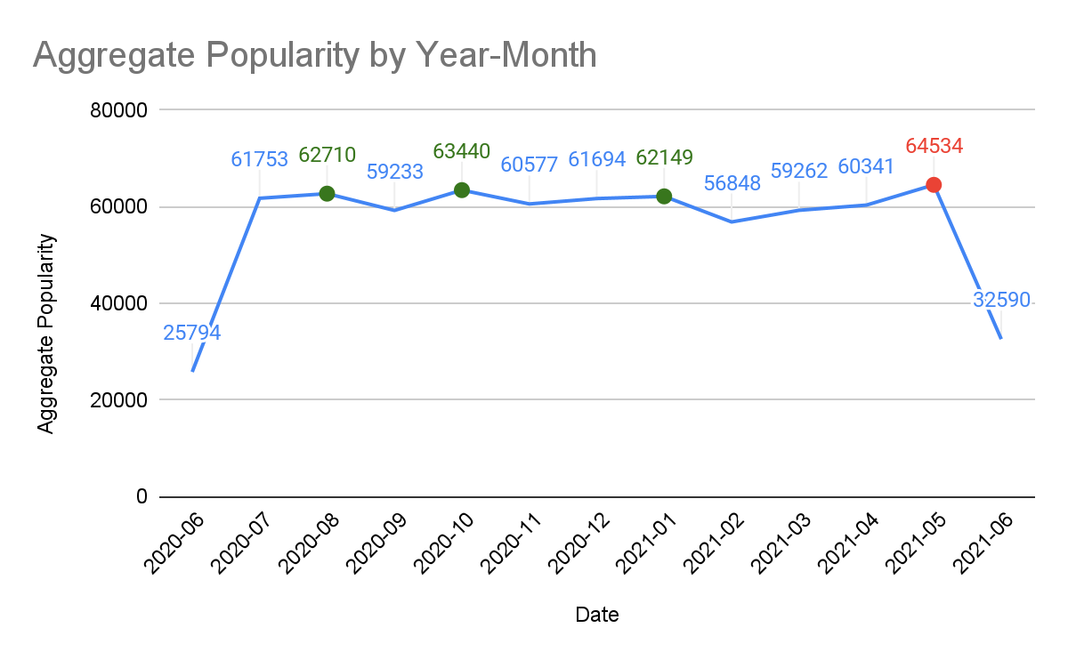
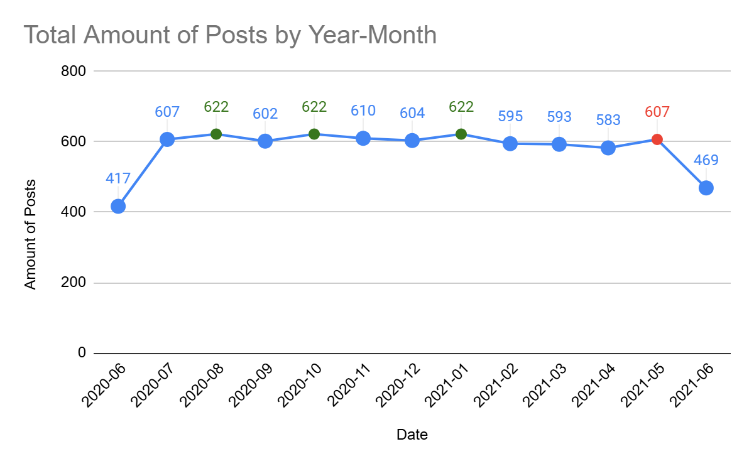
Date Insight
May has the highest popularity of 64,534 which is followed by October, August, and November
Despite May having the highest popularity score, it does not have the most posts which is tied at 622 between October, August, and November

Slide 11

Top 5 popular categories (travel, science, healthy eating, animals, cooking) appear to have their positions secured and perform similar in reaction type
Content Type has a clear positive correlation between popularity and number of posts
The amount of posts sent in a month does not appear to directly affect the popularity score
Summary

Slide 12

Thank you!
ANY QUESTIONS?

